Slide 1
The Total Economic Impact™ of HPE Nonstop Systems
Quantifying the business value of continuous availability

Slide 2
Agenda
What we’ll cover
03 | The modern infrastructure challenge
04 | Study methodology
05 | Financial outcomes
06 | Operational outcomes
07 | Legacy limitations and the cost of downtime
08 | HPE Nonstop Systems
09 | Quantified benefit: Improved uptime
11 | Quantified benefit: Enhanced security
13 | Quantified benefit: Increased scalability
15 | Strategic business impact
18 | Total investment breakdown
19 | The cost of inaction
20 | Turning continuous availability into predictable business value
Confidential | Authorized HPE Partner Use Only

Slide 3

The modern infrastructure challenge
Rising expectations are redefining the role of infrastructure
AI acceleration is increasing expectations for performance, resilience, and data availability
Enterprises face growing pressure to support digital transformation, continuous operations, and regulatory requirements
Infrastructure is increasingly expected to support business continuity, performance, and digital innovation—not just system uptime
Confidential | Authorized HPE Partner Use Only
Notes:
Organizations are operating in an environment where expectations around availability and performance continue to increase. The acceleration of AI, digital services, and real-time operations is placing new demands on infrastructure to deliver not only uptime, but also consistent performance, resilience, and trusted data availability.
At the same time, enterprises must support ongoing digital transformation initiatives while navigating increasingly complex regulatory and operational requirements.
As a result, infrastructure is no longer viewed solely as an operational necessity. It is increasingly expected to support business continuity, customer experience, and the ability to deliver reliable digital services at scale.
This context helps explain why organizations are re-evaluating traditional approaches to availability and resilience—and sets the stage for the study methodology we’ll review next.

Slide 4
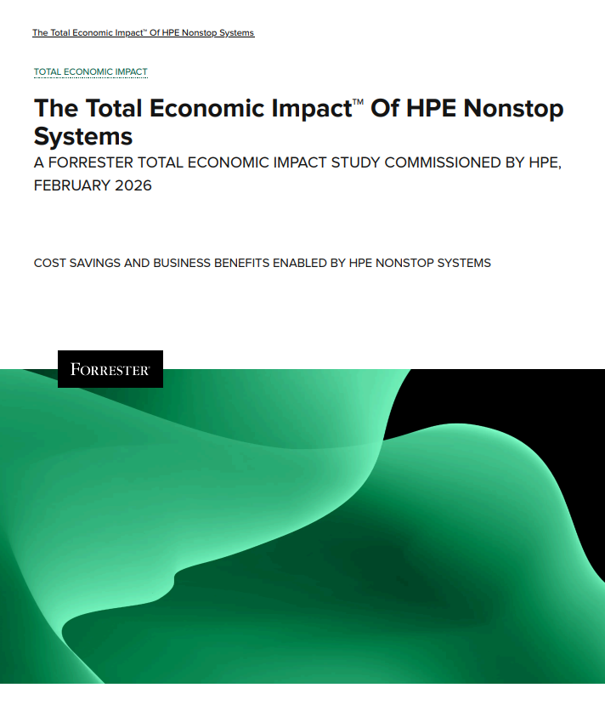
Independent study methodology
The Total Economic Impact™ of HPE Nonstop Systems
Purpose: Provide a framework to evaluate the potential financial impact of HPE Nonstop Systems on their organizations
Commissioned by HPE, February 2026
In-depth interviews with decision-makers across Financial Services and Smart Manufacturing
$50B composite organization created to model real-world financial impact
Confidential | Authorized HPE Partner Use Only
Source: Forrester, The Total Economic Impact™ of HPE Nonstop Systems - Framework and Methodology, February 2026.
Notes:
This research was designed to provide organizations with a structured framework for evaluating the potential financial and operational impact of adopting HPE Nonstop Systems.
The study was commissioned by HPE and conducted by Forrester Consulting in February 2026 using the Total Economic Impact methodology, which examines both quantified benefits and associated costs over time.
To build the analysis, Forrester conducted in-depth interviews with six decision-makers across financial services and smart manufacturing—environments where downtime carries significant operational and financial consequences.
These insights were then used to construct a composite organization with approximately $50 billion in annual revenue. This model allows the findings to reflect real-world enterprise conditions while protecting the confidentiality of individual participants and providing a risk-adjusted view of outcomes.

Slide 5




Financial outcomes observed in the study
Significant ROI and business value
103%
$56M
Return on investment (ROI)
Net present value (NPV)
<6-month
$110.4M
Payback period
Total benefits (3-year present value)
Confidential | Authorized HPE Partner Use Only
Source: Forrester, The Total Economic Impact™ of HPE Nonstop Systems - Executive Summary, February 2026.
Notes:
The study found that organizations adopting HPE Nonstop Systems realized measurable and significant financial value.
For the composite organization, Forrester calculated a 103 percent return on investment and a net present value of approximately 56 million dollars over a three-year period.
An important aspect of these results is the speed of value realization. The analysis showed a payback period of less than six months, indicating that operational and risk-reduction benefits begin offsetting the initial investment relatively quickly. In total, the study quantified approximately 110 million dollars in risk-adjusted benefits. These outcomes were driven primarily by reduced downtime, improved operational efficiency, and the ability to scale mission-critical workloads with greater reliability.
These financial highlights provide a foundation for understanding the operational challenges organizations faced prior to adoption, which we’ll explore next.

Slide 6



Operational outcomes observed in the study
Availability & resilience
Security
Performance & agility
reduction in downtime frequency and duration
reduction in breach
risk exposure
increase in transaction throughput
90%
75%
~7%
availability improved
from 99.5%
reduction in
security alerts
faster provisioning
and testing
99.99%-100%
40-60%
50%
improvement in
operating margin
reduction in security monitoring effort
reduction in patching and maintenance windows
0.2%
50%
18-20%
Confidential | Authorized HPE Partner Use Only
Source: Forrester, The Total Economic Impact™ of HPE Nonstop Systems - Executive Summary, February 2026.
Notes:
The study identified a consistent set of operational outcomes across interviewed organizations.
From an availability perspective, organizations experienced a 90 percent reduction in downtime and improved availability from approximately 99.5 percent to the 99.99 to 100 percent range, enabling more predictable service delivery for mission-critical workloads.
Security improvements were also notable, including a 75 percent reduction in breach risk exposure, a significant decrease in alert volume, and a 50 percent reduction in security monitoring effort — allowing teams to focus more on proactive risk management rather than reactive response.
In parallel, organizations reported measurable gains in performance and agility. Transaction throughput improved, provisioning and testing cycles accelerated by roughly 50 percent, and patching and maintenance activities became less disruptive to ongoing operations.
Taken together, these outcomes illustrate how improvements in availability, security, and operational efficiency reinforce one another — helping organizations reduce disruption while supporting growth and innovation.

Slide 7

Legacy limitations and the cost of downtime
Operational strain and financial exposure in legacy environments
Outdated equipment: Costly downtime and operational disruption. 43.8 hours of annual downtime prior to modernization
Overwhelmed infrastructure teams: Heavy troubleshooting burden, limited resources to support growing demands
Market and compliance pressures: Difficulty keeping pace with transaction growth and regulatory requirements
The cost of downtime… is around $2M to $2.7M for every hour… as you go beyond four hours, that could go up to tens of millions.”
Technology leader, Financial Services
“
Source: Forrester, The Total Economic Impact™ of HPE Nonstop Systems - Executive Summary, February 2026.
Confidential | Authorized HPE Partner Use Only
Notes:
Why was this study conducted?
This study was conducted in response to several major shifts shaping how organizations think about infrastructure and availability.
First, expectations have fundamentally changed. Customers, partners, and internal users now assume services will be available at all times.
Downtime is no longer viewed as an occasional inconvenience — it directly impacts experience, trust, and revenue.
Second, outages increasingly represent financial and operational exposure. Even short disruptions can create cascading effects, including lost transactions, regulatory risk, and reputational damage that extends well beyond the duration of the incident.
Finally, infrastructure itself has become strategic. Organizations are no longer evaluating availability purely as a technical metric. Instead, resilience, scalability, and continuous operations are influencing competitiveness, innovation, and the ability to support real-time digital business models.
These pressures ultimately led Forrester to examine how organizations can move beyond traditional failover approaches toward continuous availability—and what the financial and operational impact of that shift looks like in practice.

Slide 8
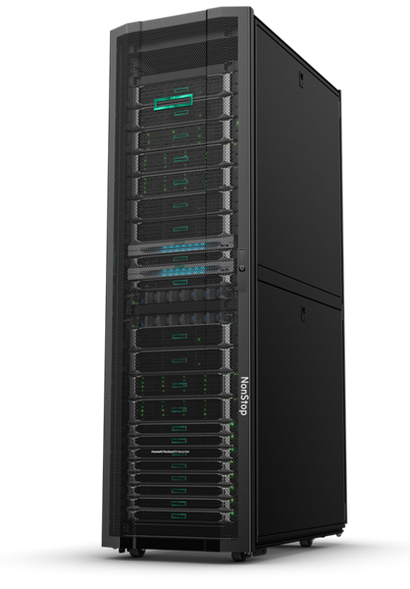
Introducing HPE Nonstop Systems
Engineered for continuous availability
Technical edge
Fully integrated, fault-tolerant compute platform
Shared-nothing, full-system clustered architecture
Millisecond-level takeover with no service interruption
Confidential | Authorized HPE Partner Use Only
Source: Forrester, The Total Economic Impact™ of HPE Nonstop Systems - The HPE Nonstop Systems Customer Journey, February 2026.
Notes:
To understand how organizations achieved the operational improvements highlighted earlier, it’s important to look at the architectural foundation behind them.
HPE Nonstop is designed as a fully integrated, fault-tolerant compute platform built specifically for environments where continuous availability is required.
The platform uses a shared-nothing, full-system clustered architecture, which helps eliminate single points of failure and allows system components to operate independently while maintaining overall service continuity.
This design enables millisecond-level takeover between system components, meaning that if a failure occurs, workloads continue running without noticeable interruption.
This architectural approach is what allows organizations to maintain service continuity while supporting demanding, mission-critical workloads.

Slide 9
How continuous availability translates to measurable value
Confidential | Authorized HPE Partner Use Only
Notes:
The following findings reflect how architectural resilience drives operational and financial outcomes observed in the study.

Slide 10

Achieving near-continuous availability
Benefit: Improved uptime
Key findings:
reduction in downtime frequency and duration
increased from 99.5% to the 99.99% - 100% range
Quantified value:
$86.4M
over a three-year
period
90%
Availability
Confidential | Authorized HPE Partner Use Only
Source: Forrester, The Total Economic Impact™ of HPE Nonstop Systems - Analysis of Benefits, February 2026.
Notes:
The largest quantified benefit identified in the study was improved uptime, representing approximately 86.4 million dollars in value over the three-year period.
Interviewed organizations reported a significant reduction in both the frequency and duration of downtime events, with outages becoming far less disruptive to daily operations.
As a result, availability improved from a baseline of approximately 99.5% into the 99.99% to near-continuous availability range.
While the percentage change may appear incremental, the operational impact is substantial. Even small improvements in availability translate into meaningful reductions in service disruption, recovery effort, and revenue exposure for mission-critical workloads.
The following slide looks more closely at the operational mechanisms behind this improvement, particularly the role of seamless failover and performance stability.

Slide 11
Eliminating the “switchover gap”
Benefit: Improved uptime
Key findings:
failover maintains transaction continuity during component failures
improvement in total transactions per second (TPS)
performance maintained during failover and peak demand
~7%
Seamless
Consistent
Confidential | Authorized HPE Partner Use Only
Source: Forrester, The Total Economic Impact™ of HPE Nonstop Systems - Analysis of Benefits, February 2026.
Notes:
Beyond overall availability improvements, interviewed organizations highlighted the importance of eliminating the traditional switchover gap that occurs during component failures.
With seamless failover, workloads continue processing without interruption, preventing transaction backlogs and reducing operational disruption during failure events.
This continuity contributed to measurable performance improvements, including an approximate seven percent increase in total transactions per second.
Organizations also reported consistent performance during failover scenarios and periods of peak demand, reinforcing confidence that mission-critical workloads could be sustained even under stress conditions. Together, these operational characteristics help explain how improvements in availability translated into tangible performance and business continuity gains.

Slide 12
Reducing security risk exposure
Benefit: Enhanced security
Key findings:
in reduced security risk exposure
reduction in exposure to breach-related costs
reduction in platform-level security alerts
decrease in unauthorized access attempts
Quantified value:
$758k
75%
40–60%
30–40%
Confidential | Authorized HPE Partner Use Only
Source: Forrester, The Total Economic Impact™ of HPE Nonstop Systems - Analysis of Benefits, February 2026.
Notes:
In addition to availability improvements, the study identified meaningful gains in overall security posture.
Interviewed organizations reported a significant reduction in exposure to breach-related costs, driven by stronger system resilience, improved access control, and reduced vulnerability windows during operations and maintenance.
Organizations also experienced a substantial decline in platform-level security alerts. This reduction helped security teams focus more effectively on meaningful threats rather than managing high volumes of low-value notifications.
Additionally, improvements in access control and system hardening contributed to a reported decrease in unauthorized access attempts, further strengthening confidence in the platform’s ability to support mission-critical workloads securely.
Together, these outcomes reflect not only reduced security risk, but also improved operational clarity and confidence in maintaining a resilient security posture.

Slide 13
Proactive protection without disruption
Benefit: Enhanced security
Key findings:
reduction in patching and maintenance disruption
reduction in security monitoring effort
controls supporting Zero Trust security principles
18–20%
~50%
Centralized
Confidential | Authorized HPE Partner Use Only
Source: Forrester, The Total Economic Impact™ of HPE Nonstop Systems - Analysis of Benefits, February 2026.
Notes:
Beyond strengthening overall security posture, interviewed organizations also reported meaningful improvements in day-to-day security operations.
Patching and maintenance activities became less disruptive, with reduced downtime and more efficient update processes contributing to shorter maintenance windows overall.
Organizations also experienced a significant reduction in monitoring effort. With fewer false positives and improved visibility into meaningful events, security teams were able to shift focus from reactive alert management toward higher-value security activities.
In addition, centralized management capabilities supported stronger access governance and alignment with Zero Trust security principles, improving consistency and control across environments.
Together, these operational improvements reduced security workload while allowing organizations to maintain stronger protection without introducing additional disruption.

Slide 14

Growth without linear cost
Benefit: Increased scalability
Key findings:
improvement in overall operating margin
faster provisioning and testing cycles
Quantified value:
Business impact:
Efficiency:
$23.3M
over a three-year
period
0.2%
50%
Confidential | Authorized HPE Partner Use Only
Source: Forrester, The Total Economic Impact™ of HPE Nonstop Systems - Analysis of Benefits, February 2026.
Notes:
The study also identified scalability and agility as meaningful contributors to overall business value, representing approximately 23.3 million dollars in benefits over the three-year period.
Interviewed organizations reported that improved scalability allowed them to support growing transaction volumes and new initiatives without requiring proportional increases in infrastructure complexity or cost.
This flexibility contributed to an overall improvement in operating margin, as organizations were able to accelerate product delivery, support expansion, and capture revenue opportunities more efficiently.
Operationally, organizations experienced significantly faster provisioning and testing cycles, reducing the time required to deploy new environments and enabling teams to respond more quickly to evolving business demands.
Together, these improvements reflect how scalable infrastructure not only supports growth, but helps organizations pursue that growth with greater efficiency and confidence.

Slide 15
The power of HPE GreenLake
Benefit: Increased scalability
Cloud economics for on-premises workloads
CONSUMPTION MODEL ADVANTAGES
enterprise-grade infrastructure capabilities with pay-as-you-go
large upfront capital investment requirements
infrastructure costs with actual utilization and production demand
Access
Reduces
Aligns
Confidential | Authorized HPE Partner Use Only
Source: Forrester, The Total Economic Impact™ of HPE Nonstop Systems - Analysis of Benefits, February 2026.
Notes:
A key factor enabling the scalability benefits discussed earlier was the adoption of HPE GreenLake’s consumption-based delivery model.
Interviewed organizations highlighted the value of a pay-as-you-go approach, which allowed them to access enterprise-grade infrastructure capabilities without requiring large upfront capital investments.
This shift helped organizations better align infrastructure spending with actual business demand, supporting growth while reducing the financial risk typically associated with capacity planning and overprovisioning.
By tying costs more directly to utilization and production levels, organizations were able to scale confidently while maintaining greater financial predictability and flexibility.
In this way, the GreenLake model played an important role in enabling growth without introducing proportional increases in cost or financial complexity.

Slide 16

Customer trust and experience
Benefit: Strategic business impact
Impact on brand and service quality
OBSERVED OUTCOMES
resolution of quality and service issues through real-time data visibility
risk of brand erosion associated with outages and latency
customer satisfaction driven by consistent service availability
Faster
Reduced
Improved
Confidential | Authorized HPE Partner Use Only
Source: Forrester, The Total Economic Impact™ of HPE Nonstop Systems - Analysis of Benefits, February 2026.
Notes:
Beyond the quantified financial and operational benefits, interviewed organizations emphasized the importance of consistent availability in maintaining customer trust and protecting brand reputation.
Continuous access to real-time data allowed organizations to identify and resolve quality or service issues more quickly, reducing the likelihood of prolonged customer impact.
Interviewees also noted that minimizing latency and preventing outages helped avoid the reputational damage that can occur when customers experience service disruption.
Over time, this consistency contributed to improved customer satisfaction and greater confidence in service reliability, reinforcing the broader business value of continuous availability beyond the financial model.

Slide 17
Future-ready data and innovation
Benefit: Strategic business impact
Foundations for AI and advanced analytics
OBSERVED OUTCOMES
high-quality data environments supporting AI and analytics initiatives
data availability enabling advanced analytics and predictive capabilities
data integrity reducing risk of corruption and inconsistent processing
Standardized,
Real-time
Strong
Confidential | Authorized HPE Partner Use Only
Source: Forrester, The Total Economic Impact™ of HPE Nonstop Systems - Analysis of Benefits, February 2026.
Notes:
In addition to immediate operational and financial benefits, interviewed organizations highlighted the role of continuous availability in supporting future innovation.
Standardized and consistently available data environments provided a strong foundation for advanced analytics and emerging AI initiatives, allowing organizations to explore new capabilities with greater confidence.
Real-time access to reliable data also enabled more proactive operational insights, including predictive analysis and improved decision-making across business processes.
Organizations further emphasized the importance of strong data integrity, noting that reducing the risk of corruption and inconsistency helps ensure that analytics, automation, and AI initiatives are built on trustworthy information.
Together, these factors position continuous availability not only as a resilience strategy, but as an important enabler of long-term innovation and digital transformation.

Slide 18
Flexibility and sustainability
Benefit: Strategic business impact
Strategic long-term value
OBSERVED OUTCOMES
supporting future post-quantum cryptography requirements
Reported sustainability improvements driven by infrastructure modernization and resource optimization, including up to
Architectural readiness
30% reduction in carbon impact
Confidential | Authorized HPE Partner Use Only
Source: Forrester, The Total Economic Impact™ of HPE Nonstop Systems - Analysis of Benefits, February 2026.
Notes:
Interviewed organizations also highlighted longer-term strategic benefits related to flexibility and sustainability.
From a security perspective, organizations noted that the platform’s architectural approach supports readiness for future cryptographic requirements, helping ensure that infrastructure investments remain viable as security standards evolve.
In addition, modernization efforts enabled more efficient resource utilization, contributing to reported sustainability improvements and reductions in environmental impact.
Some organizations associated these improvements with meaningful reductions in carbon footprint as workloads became more efficiently distributed and infrastructure utilization increased.
Together, these factors reflect how continuous availability platforms can support not only immediate operational needs, but also long-term strategic priorities related to resilience, adaptability, and sustainability.

Slide 19

Total investment breakdown
Investment reflects long-term infrastructure capability rather than implementation overhead
Deployment and administration
$7.1M
Internal FTE effort, implementation, and training
Platform
$47.3M
Licensing, hardware, and GreenLake consumption
Investment
Confidential | Authorized HPE Partner Use Only
Source: Forrester, The Total Economic Impact™ of HPE Nonstop Systems - Analysis of Costs, February 2026.
Notes:
The study modeled total investment for the composite organization at approximately 54.4 million dollars over three years on a present value basis.
The majority of this investment — roughly 87 percent — reflects the platform itself, including licensing, hardware, and GreenLake consumption. This represents the infrastructure required to support continuous availability, scalability, and resilience across mission-critical workloads.
A smaller portion of the investment relates to deployment and administration, including internal labor and training needed to implement and operate the environment effectively.
This distribution highlights that most of the investment is directed toward long-term capability rather than implementation overhead, reinforcing the durability of the platform’s value over time.
When viewed alongside the quantified benefits discussed earlier, these costs help frame the broader economic balance between investment, risk reduction, and operational improvement.

Slide 20

The cost of inaction
What remains at risk without continuous availability
Exposure and missed opportunity
Up to 43.8 hours of annual downtime exposure remains
Potential losses of $2M–$2.7M per hour during outage events
Missed opportunity to achieve 90% reduction in downtime and near-continuous availability
Foregone performance gains, including improved transaction throughput and scalability
Continued operational and financial unpredictability compared to the modeled $56M net value realization
Nonstop is not inexpensive, but it replaces unpredictable, high-impact operational risk with a stable, predictable cost structure.”
IT operations leader
“
Source: Forrester, The Total Economic Impact™ of HPE Nonstop Systems - Analysis of Costs, February 2026.
Confidential | Authorized HPE Partner Use Only
Notes:
While the study demonstrates meaningful financial and operational benefits, interviewed organizations emphasized that the decision is ultimately about risk management as much as return on investment.
Without modernization, organizations remain exposed to meaningful downtime risk, including an average of 43.8 hours of annual disruption and potential outage costs reaching several million dollars per hour.
In addition to direct financial exposure, organizations forgo the opportunity to significantly reduce downtime, improve performance, and scale infrastructure with greater predictability.
Perhaps most importantly, continuing with legacy environments preserves operational uncertainty, where infrastructure costs and outage impact remain volatile rather than predictable.
As one interviewee noted, the value of the platform is not simply in reducing cost, but in replacing unpredictable, high-impact operational risk with a stable and manageable cost structure.
The decision is less about infrastructure cost and more about replacing unpredictable operational risk with predictable business stability.

Slide 21
Turning continuous availability into predictable business value
Explore how these outcomes could apply to your environment with a tailored TEI assessment.
Confidential | Authorized HPE Partner Use Only
Source: Forrester, The Total Economic Impact™ of HPE Nonstop Systems - The HPE Nonstop Systems Customer Journey, February 2026.
Notes:
This study demonstrates that continuous availability is not simply an infrastructure enhancement, but a meaningful shift toward more predictable, resilient operations.
Across the composite organization, improved uptime, reduced risk exposure, and greater scalability translated into measurable financial value alongside important strategic benefits such as customer trust and future innovation readiness.
Importantly, the findings also highlight that the decision is not only about return on investment, but about replacing operational uncertainty with greater stability and confidence in supporting mission-critical workloads.
The next step is to understand how these modeled outcomes may translate within your own environment, considering workload criticality, growth expectations, and risk tolerance.
A tailored assessment can help quantify the potential impact and identify where continuous availability could deliver the greatest value for your organization.

Slide 22


The business impact of security & resilience
A Forrester TEI study quantifying the financial and operational value of HPE Nonstop Systems
Proven financial
value
Measurable operational improvement
Long-term strategic
advantage
103% ROI
$56M net present value
Payback in under
6 months
$110.4M total benefits
(3-year PV)
90% reduction in downtime
Availability improved to 99.99% - $100%
75% reduction in breach risk exposure
~50% faster provisioning and testing
Continuous availability replaces unpredictable outage risk
Enables secure, scalable growth without operational fragility
Establishes a foundation for real-time analytics and innovation
Confidential | Authorized HPE Partner Use Only
Source: Forrester, The Total Economic Impact™ of HPE Nonstop Systems, February 2026.
Notes:
At a high level, the study demonstrates that continuous availability delivers meaningful business impact across financial, operational, and strategic dimensions.
Financially, the composite organization achieved a 103 percent return on investment, a 56-million-dollar net present value, and payback in under six months, reflecting the significant value associated with reducing downtime and improving resilience.
Operationally, organizations reported substantial improvements in availability, security posture, and scalability, including major reductions in downtime, stronger protection against security risk, and faster provisioning that enabled teams to respond more quickly to changing business needs.
Beyond these measurable outcomes, the study highlights broader strategic value. Continuous availability helps replace unpredictable outage risk with greater operational stability, supports secure and scalable growth, and provides a reliable data foundation for real-time analytics and emerging AI initiatives.
Together, these outcomes contribute to improved operational predictability, giving organizations greater confidence in planning, scaling, and supporting mission-critical workloads over the long term.

Slide 23
Thank You
See the study: https://tei.forrester.com/go/HPE/HPENonstop/?lang=en-us
Try the online calculator: https://forresterstage.mainstayadvisor.com/go/HPE/HPENonstop/?lang=en-us
a00157803enw
Confidential | Authorized HPE Partner Use Only

