Slide 1



NonStop in the Enterprise
Modernizing with Client Solutions

Slide 2
agenda
Why Modernize ?
Advantages
Modernizing Examples
Conclusions
Next Steps

Slide 3
Why Modernize ?
Standardization
To improve Security
To get more from current systems
In conjunction with Windows 7 rollout
Support Mobile devices
Encourage Collaboration
To create Business Value
GET THE RIGHT DATA
TO THE RIGHT PEOPLE
AT THE RIGHT TIME
  Increase efficiency and productivity
  Provide business advantage

Slide 4
Modernizing Objectives
Business 1. Increase Revenue
2. Successfully manage change
IT Support business innovation while mitigating risk -
A. with easy-to-use, seamless information services
B. improved interoperability between systems

Slide 5
“ Client Solution “ Advantages
Produce results quickly
Focus on delivering Business Value
Fast ROI
Reduce risk while managing change
Facilitates collaboration / communications
Position NonStop as part of the Corporate Standard
Leverage the investment in current systems ….
.

Slide 6
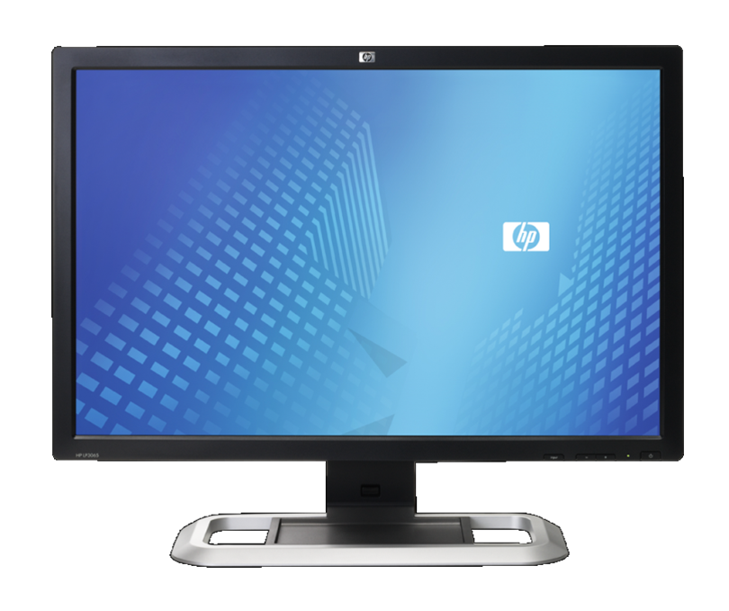
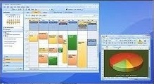
Modernization -
with Client Solutions
Customer examples

Slide 7
Modernizing Systems
Information Access Options
1. Emulation
  6530
  3270
  5250
  VT
  T27
  X
  etc.
  … the “ Data “ is the platform
2. ODBC
3. SOAP
4. RPC
5. Messaging / Middleware
6. Client / Server
7. PC / Windows
8. Internet (HTML, etc.)
… Hybrid system environment

Slide 8
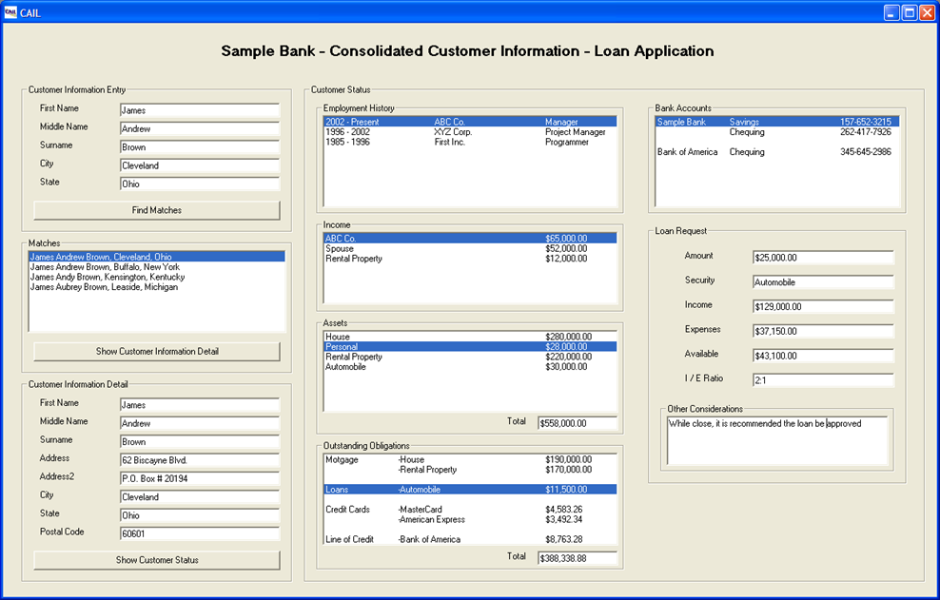
ModerniZe - Text Style
Display Example A

Slide 9
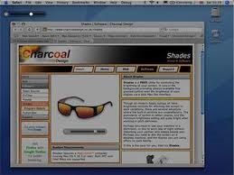
ModerniZe - Web Page
Display Example B

Slide 10
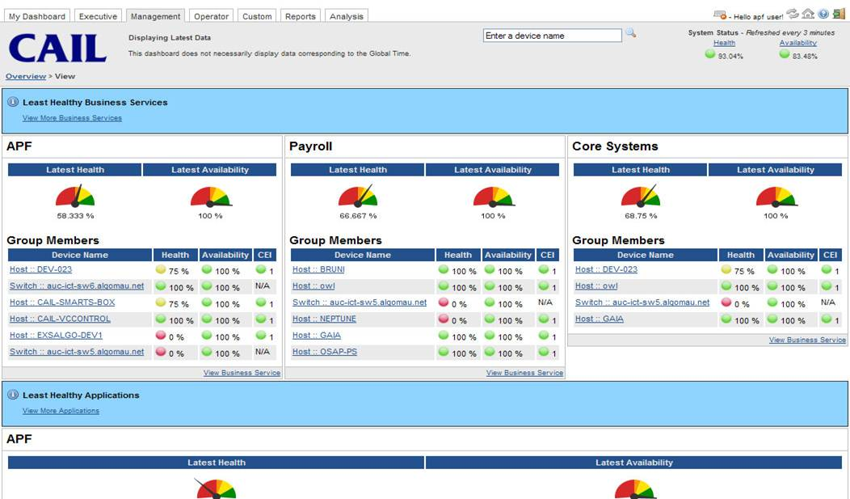
ModerniZe - Dashboard
Display Example C

Slide 11

1. Simplifying Systems
Manufacturer
One-Time Log-in then subsequent auto-logins for validated Users
Seconds vs minutes
  User clicks on a Web Page to bring up a 6530 session
  Script puts the cursor on the correct page and location
  (vs start a session, log-in, go to desired screen,
  find the field, etc.)
Instantiate the CAIL ActiveX Control inside the Browser (put a TAG inside HTML file + configure)
Typically no software installed on the PC or laptop

Slide 12
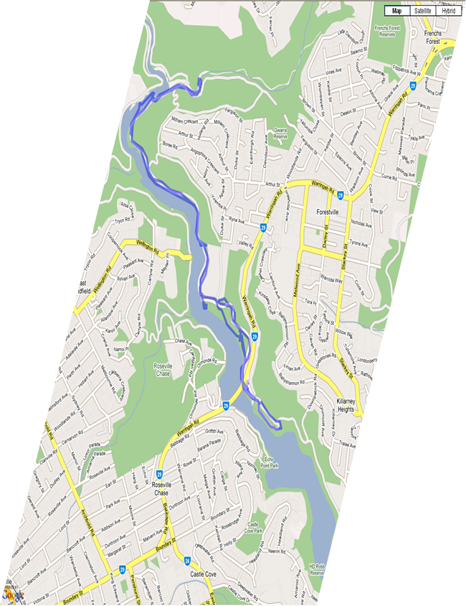
2. Single View
Logistics Company
Dynamically updates maps based on information from multiple NonStop sessions
Prompts user through sub-windows
Add CAIL 6530 ActiveX control in the Development Environment Tool Box
  like other Windows Controls to Grab the Tool and drop onto a form
Applicable to C+, C++, Visual Basic, etc.
programming environments
Use Microsoft ClickOnce to streamline deployment
  application installed when User clicks on a link in a Web Page
  User does not require Admin rights
  MS code signing
  The application runs in a “Sandbox”

Slide 13

3. Faster Response
911 Emergency Response
Validate information before triggering response unit
  save lives and time through right people to correct address
“CAIL COM” interfacing used in a application to pass information from the NonStop session to a Server containing valid addresses
Automatic confirmation or close match responses
Operator has appropriate information to confirm with requesting party specific details (i.e. the corrected address)
“CAIL COM” was selected because the Customer didn’t want to change the NonStop application

Slide 14

4. Improve System Security
Many Organizations
Utilise built-in CAIL Suite security capabilities
Activate encryption for
  6530 Sessions
  File Transfers
Authenticate Users
Choice of SSH, SSL, etc. encryption
Verify SSL Client Certificates, username and
serial number against a Server database
Auditing capabilities
FIPS 140-2 Compliance
For SSH, choice of Guardian or OSS implementations

Slide 15

5. Better Disaster Recovery Contingency
Australian Bank
Person clicks on a browser link to a pre-setup Web Page to start a session that connects to the DR system
Instantiate the CAIL ActiveX Control inside a Browser
Have full 6530 support including -
  Function Keys
  Tool Bar
  Multiple 6530 Sessions
  Encrypted Communications
  Encrypted File Transfer
… SFTP (SSH), FTPS (SSL)

Slide 16
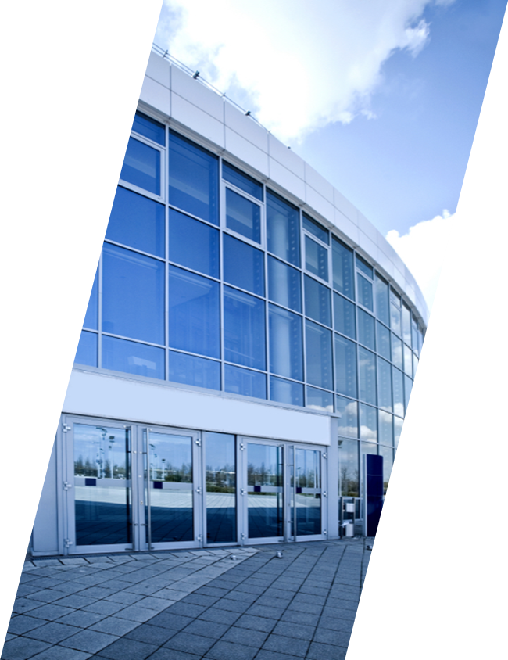
6. AutomatE Processes
Various Organizations
Automatically trigger a process
  Create a report / alert
  Send notifications
  Invoke corrective action routine
Embed the CAIL ActiveX Control for 6530 communications into Customer system management software / applications

Slide 17

7. Partnering Solutions
To improve system manageability and NonStop usability, the CAIL ActiveX Control (for 6530 communications) has been embedded into Partner Products
  MOMI / Blackwood Systems
  The View / River Rock Software
  etc.
For seamless solutions
  Increase product capabilities
  Integrate information with Customer applications
  Improve responsiveness to Customer requests

Slide 18
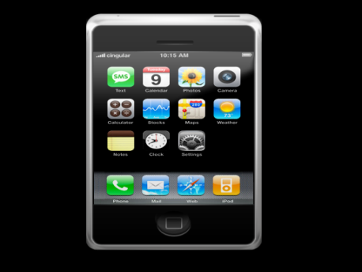
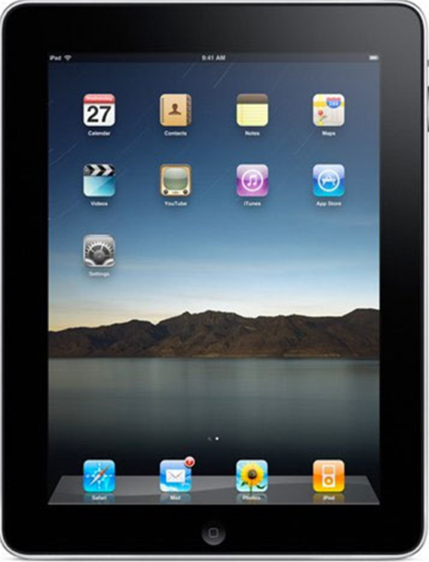
8. Mobile
Customer Example - Military
Easily enable new Client devices to connect with NonStop systems (e.g. Smart Phones, Tablets etc.)
Easily capture information by utilising CAIL inside a Scanner with scanned barcodes inserted into the correct field on the screen
Achieved by running CAIL Java on an ARM based mobile device with NonStop access from any mobile device supporting Java

Slide 19
9. “ Enterprise client Solution “
Reflection / EXTRA! - Integrated CAIL / Attachmate Software
A Corporate Standard for Host access …. a single icon for quick, easy, consistent access to - Mainframe, Mid-Range, UNIX/Linux, NonStop, etc. systems
Secure systems across the enterprise
Modernize with information from “ selected ” or “ all ” systems
Reduce training and support demands
Simplify systems
Increase profile and opportunities for NonStop
Save significant $

Slide 20
Why Standardize ? To Deliver results fast
+ meet expectations
Grief
Complexity
R O R
Gratification
Time

Slide 21
Why standardize ? To Reduce Risk and Cost
+ make it easier to move forward
High
$
Medium
Low
Time

Slide 22
Next Step :
1. Evaluate “ CAIL “ to modernize NonStop systems
2. Utilize “ Reflection “ or “ EXTRA! “ (integrated Attachmate / CAIL Software) to modernize all information services (including NonStop) with an Enterprise Client Solution
For more information, please visit www.cail.com or contact CAIL
info@cail.com
800-668-5769
Ron Thompson
rthompson@cail.com

